Slide 1
INTRODUCTION BACKGROUND
50 Million People
Have epilepsy around the world
9.9 per 1000 People
Prevalence of epilepsy in Pakistan
Risk of Premature Death
3x more than general population
Notes:
https://www.ncbi.nlm.nih.gov/pmc/articles/PMC8794165/

Slide 2
IOT-VISION ENABLED ASSISTANCE FOR EPILEPTIC PATIENTS

Slide 3

TEAM PRESENTATION
Muhammad Ali Murtaza 2020-CS-114
Zeshan Ayub 2020-CS-113
Ali Tariq 2020-CS-142
Syed Azeem Ali Hashmi 2020-CS-156

Slide 4

COST OF ILLNESS (COI)
According to Emory University School of Medicine
 | Cost in Euro (3 Months) | Cost in PKR (3 Months) | Cost in PKR (1 Month)
Focal | €4911 | PKR 15,21,542 | PKR 5,07,180
Genetic Generalized | €2782 | PKR 8,61,928 | PKR 2,87,309
Unclassified Epilepsy | €2598 | PKR 8,04,921 | PKR 2,68,307
Average COI is PKR 3,54,265 !!!
Notes:
https://www.ncbi.nlm.nih.gov/pmc/articles/PMC10131573/

Slide 5








PROBLEM STATEMENT
High risk of death
Real time alerts
Patient
Challenges
Audience
Problems
24/7 monitoring required
Family
Costly monitoring solutions
Data Security
Caretaker staff

Slide 6




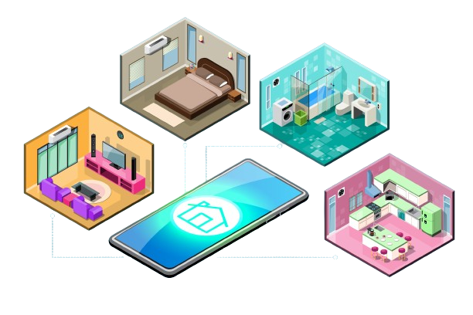
PROPOSED SOLUTION
IoT-Vision Enabled Assistant for Epileptic Patients
Alert in Emergency Situation
Seizure Forecasting
Daily Activity Monitoring
Seizure Detection

Slide 7
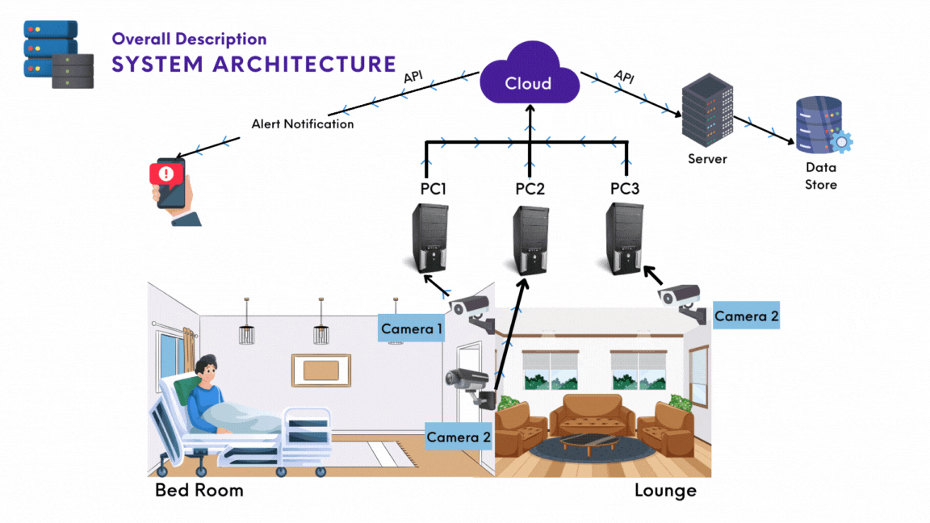
7

Slide 8
POSSIBLE SOLUTION CATEGORIES
Monitoring Solutions
Technological Solutions
Camera Based Monitoring
Sensor Based Monitoring
Manual Solutions
Nursing/Caretaker staff
Family Members
IoT-Vision Enabled Assistant for Epileptic Patients

Slide 9

SOLUTIONS PROS & CONS
Pros
IoT-Vision Enabled Assistant for Epileptic Patients
Cons
Sensor based Monitoring
Cost Effective
Live monitoring
Less human dependence
Non-intrusive, non allergic
Traditional Monitoring
Sensors provide accurate data
Cheap in price
Constant human support
Less error prone
Costly solution
Burden on caretaker staff
Sensors can malfunction
Require constant contact with patient body
Privacy breaching threat
Limited Environmental range
Camera based Monitoring
Area of interest

Slide 10



WHY CAMERA BASED APPROACH IS OPTIMAL
Non-intrusive and non-allergic
Cost effective solution
Remote visual monitoring

Slide 11
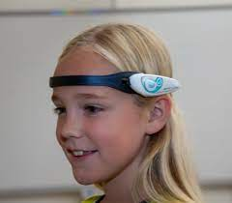
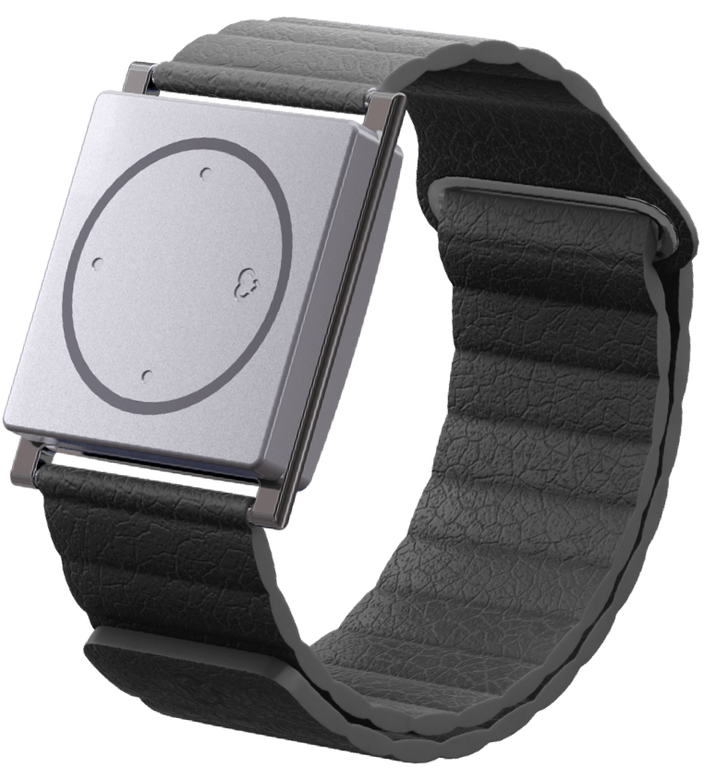
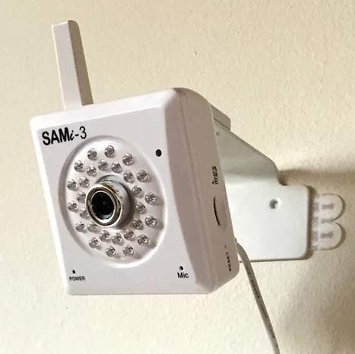
RECENT MARKET PROJECTS
Epihunter
Cost: $825.91 – $1,515.91
Detector Location: Scalp
Technique: EEG Signal
Embrace 2
Cost: $249
Subscription: $9.90-$44.90
Detector Location: Wrist
Technique: Sensors
SAMi
Cost: Rs 1,14,00.00
Detector Location: Wall
Technique: Vision

Slide 12

UNIQUE APPLICATION FEATURE
Personalized Machine Learning Approach
Our focus is on personalized model techniques rather than a one-fit-all approach.

Slide 13






APPLICATION AREAS
01
02
03
HOME HEALTHCARE
HOSPITALS
CARE CENTERS
04
05
06
REMOTE MONITORING
RESEARCH AND DEV
WORKPLACE SAFETY

Slide 14


Slide 15
THANKS!

